Slide 1
Critical Success Factors for Sustainable Procurement
Barbara Morton
Director, Sustainable Procurement Ltd
INGP Green Day
Asuncion, Paraguay 27 October 2014

Slide 2
Outline
Introductions
Sustainable Public Procurement as a ‘strategic enabler’
5 Critical Success Factors
Tracking progress
Delivering sustainable outcomes

Slide 3
Who we are
.
Sustainable Procurement Ltd
Manchester & Hampshire in England and Perthshire, Scotland
Specialists in training and consultancy
Technical Advisor to the Marrakech Task Force on SPP
Project Manager - UK Sustainable Procurement Task Force
Clients: over 40 countries in 10 years
ITAIPU BINACIONAL – Brazil/Paraguay through Fundación Moises Bertoni
African Development Bank
Chile - through British Embassy in Santiago
Swiss-Ghana Project with Ghana Public Procurement Agency
The Scottish Government

Slide 4
The Flexible Framework – a route map
Lead
People
Objectives, policy and communications
Procurement process
Engaging suppliers
Monitoring and reporting
Enhance
Ambition
Practice
Embed
Foundation
Time

Slide 5
1. People
Leadership
Throughout the organisation
Politicians as well as officers
Demonstrating commitment to delivering outcomes
Capability building
Training
Example: 400+ buyers trained in Scotland
Example: 30+ trained trainers in Ghana
Not just procurement
All those involved in meeting needs of organisation
E-learning tools

Slide 6
2. Objectives, Policy and Communications
Objectives:
Be clear on the outcome you are seeking to deliver
Not what you want to buy!
Policy
Keep it short and concise
Communications
Internal:
Budget-holders
Those who identify requirements
External – suppliers & contractors / non-governmental organisations / media / the public!

Slide 7
Example: Mapping Policy Priorities
‘Organisational Priorities’
Policy & Strategy
Carbon Reduction
Recyclable/ Recycled Goods
Fair & Ethical Trade
Local Sourcing
Innovation
Health Improvement
Equality and Diversity
Accessibility
Waste Reduction
Community Benefits
Energy and Resource Efficiency
A Healthy and Protected Environment
Regeneration, Jobs and Skills
Construction
Cost Savings
Safer Communities
Transport
Climate Change Adaptation

Slide 8
Keys to a good policy
Short!
Statement of intent & high level commitment
Signed off at high level to demonstrate ownership
Specific to its context:
National, institutional, departmental, etc
To demonstrate relevance and proportionality
Reviewed on a regular basis
Feedback from stakeholders should inform review

Slide 9
3. Procurement Process
Giving people the tools to get the job done
Considering sustainability throughout the process
From the very start including:
Re-thinking the need to buy anything at all!
Buying functionality not necessarily a product
Prioritising actions based on risk & opportunity
Life cycle impacts
Appropriate use of standards and labels
Relevance and proportionality
Who you are and what you are buying

Slide 10
The Procurement Cycle
Identify need & assess risk
Specification
Supplier Selection
Evaluation and Award
Supplier Management
Contract Management
Good Procurement is Sustainable Procurement
Stakeholder
and supplier engagement
Notes:
Explain that sustainability needs to be embedded and is not a bolt-on but part of good procurement.
This slide illustrates that the course continually relates to the ‘procurement cycle’ and its key stages – BUT particularly emphasises that Stakeholder and Supplier Engagement is a major consideration at every stage of that cycle and this will be referred to throughout the course.
Stakeholder and Supplier engagement in developing SPP approach includes:
Developing approach to SPP
Why, Who, How; Risks, barriers & challenges;
Stakeholders as part of the delivery process
Innovation; leadership; consultation; identifying common priorities; shared learning;
Certification, accreditation and standards; legal considerations;
Types of engagement
Benefits of co-operating on promotion of SPP
Risks of not co-operating and working together:
Stimulating new product development
Risks, barriers and challenges; legal considerations; Pre-Procurement

Slide 11
Example: Scotland’s Approach Scottish Model of Procurement
Improving supplier access to public contracts
Delivering savings and benefits
Embedding sustainability in all we do
Maximising efficiency & collaboration
Public procurement in Scotland
= £9+ billion per annum
Quality
Cost
Sustainability

Slide 12
Sustainability: at the heart of all we do
The Scottish Government
Marrakesh approach
300 public procurement professionals trained
Community benefits
Environmentally conscious
renewable power generation
sell green electricity back to the grid
Electricity
Commonwealth Games 2014 351 Jobs, 113 Apprentices
Glasgow Housing Association 577 Apprentices, 482 Trainees
energy efficiency measures
Socially responsible
3500 Training opportunities
Supported businesses
Article 19 National Framework
11 suppliers, up to £5m a year

Slide 13
4. Engaging Suppliers
Engage early
Send a strong signal to the market
Maximise the opportunities for innovation
Allow them to invest in Research & Development
Deliver sustainable solutions to meet your needs
Examples:
Scotland’s Hybrid Ferry
Scotland’s Supplier Development Programme
Scotland’s ‘Developing Markets for Third Sector Providers Programme’

Slide 14
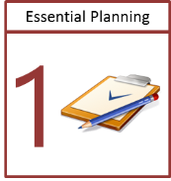
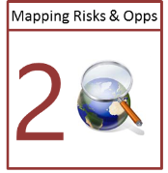
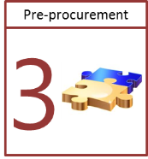
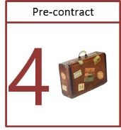
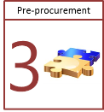
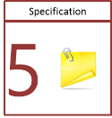
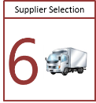
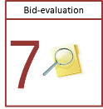
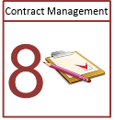
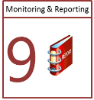
SPL Toolbox - Sustainable Procurement and You
A tailored route to embedding Sustainable Procurement
Tools and techniques are available to assist early stage planning through to monitoring and reporting. These have been developed and tested extensively. Key benefits of the Toolbox are the ability to tailor to organisational requirements and picking elements from the whole Toolbox or sections of it.
Toolbox
KNOW WHERE YOU ARE
Template organisational framework
Assessments and verification
KNOW WHERE YOU WANT TO GET TO AND HOW
Template articulated priorities
Clearly described Sustainable Outcomes – environmental, social, economic, circular economy, innovation, social value
KNOW WHAT YOU NEED TO GET THERE
Action Plan
Training and capability – materials and guidance
Policy/strategy templates and development
Stakeholder engagement – workshops and briefings
KNOW WHERE YOUR KEY RISKS AND OPPORTUNITIES ARE
Tailored priorities and sustainable outcomes
Tailored Prioritisation Methodology – category/commodity/ contract register
Market engagement and testing
PLANNING FOR POSSIBLE PROCUREMENT
Procuring a function – options appraisal, outcome based
Supplier development
Life Cycle Impact Mapping Tool
Whole Life Costs
PLANNING FOR A CONTRACT OR FRAMEWORK
Early market engagement
Contract/Framework Tool – relevance and proportionality
www.sustainableprocurement.eu.com

Slide 15
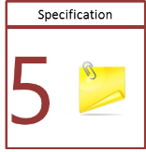
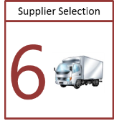
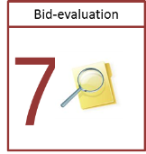
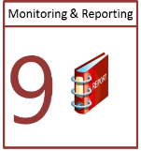
SPL Toolbox - Sustainable Procurement and You
Toolbox
KNOW HOW TO SET OUT YOUR REQUIREMENTS
Contract/Framework Tool
Guidance – general – category/commodity specific
Labels and standards
ENSURING CAPABILITY AND CAPACITY
Contract/Framework Tool
Guidance
Supplier assessment /qualification - tools and guidance
EVALUATING BIDS
Contract/Framework Tool
Guidance on evaluating bids – general – category/commodity specific
MANAGING CONTRACTS
Contract/Framework Tool
KPIs – priorities and practicalities
Guidance
MONITORING OUTCOMES AND REPORTING PROGRESS
Collating outcomes template – link to national/organisational objectives
Template reports
Assessment and review
www.sustainableprocurement.eu.com

Slide 16
5. Monitoring and Reporting
Set a baseline
Simple, robust measurement
Holding people to account for their actions
Clear reporting lines
Transparent processes leading to real accountability
Review performance and amend actions as required
Celebrate success!

Slide 17
Sustainable Procurement ‘Golden Thread’
International and national laws, policy priorities and commitments
Organisational frameworks, policy priorities, commitments and targets
Tools & techniques:
Prioritisation methodology
Procurement strategies,
action plans and
targets
Corporate Procurement Strategy
Life cycle impact mapping
Projects,
products
services
Product & supplier selection

Slide 18
The Flexible Framework – a route map
Lead
People
Objectives, policy and communications
Procurement process
Engaging suppliers
Monitoring and reporting
Enhance
Ambition
Practice
Embed
Foundation
Time

Slide 19
Summary
Developing Sustainable Public Procurement Policy
Involve all relevant stakeholders early
Keep it short and specific to its context
Monitor and track progress
Review and update policy
For Scotland ‘public procurement is a strategic enabler’
Public procurement can deliver sustainable outcomes

Slide 20
Thank you for your attention
Barbara Morton
Sustainable Procurement Ltd
+44 (0)7766 023560
barbara@sustainableprocurement.eu.com
www.sustainableprocurement.eu.com

